Slide 1
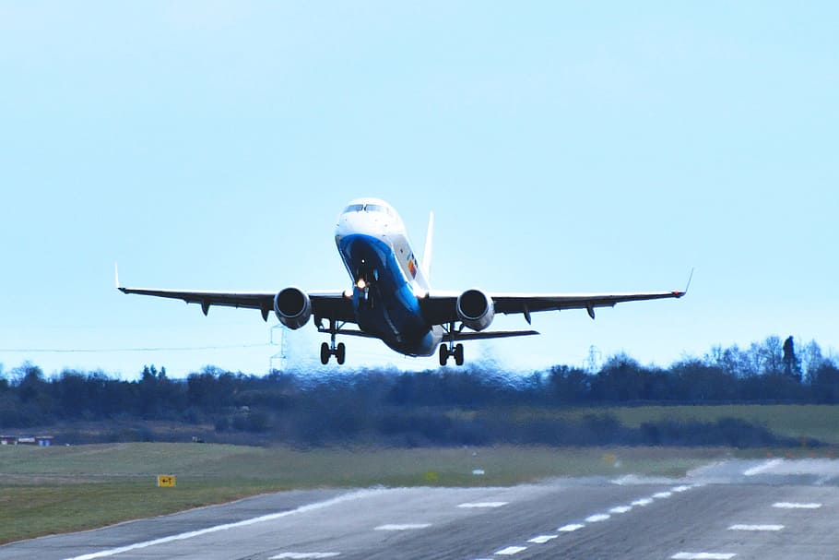
Flight Price Prediction
By – Akshay Shingavi

Slide 2
Summary
INTRODUCTION
PROBLEM STATEMENT
BENEFITS OF FLIGHT PRICE PREDICTION
EXPLORATORY DATA ANALYSIS STEPS
VISUALIZATIONS: UNIVARIATE, BIVARIATE, AND MULTIVARIATE
OUTLIERS AND CORRELATIONS
MODEL BUILDING
HYPERPARAMETER TUNING AND CREATING THE FINAL MODEL
SAVED THE MODEL AND PREDICTION RESULTS
CONCLUSION

Slide 3
Introduction
In order to maximize income, the airline industry employs dynamic pricing tactics that are among the most complex since they are based on secret factors and proprietary algorithms. Because of this, airline firms employ sophisticated algorithms to determine the cost of aircraft tickets. The cost of the plane ticket is influenced by a number of different elements.
All of the criteria are known to the vendor, but purchasers may only access a small amount of information that is insufficient to forecast flight costs. The ideal time to purchase the ticket will be determined by factors like departure time, arrival time, and time of day.
The number of persons taking aircraft has dramatically grown in recent years. Since prices fluctuate owing to several factors, it is challenging for airlines to maintain their prices. To address this issue, we shall attempt to apply machine learning models. Foreseeing what costs airlines can keep, can be helpful. Customers may use it to forecast future flight costs and make travel plans accordingly.

Slide 4
Problem statement
Anyone who has booked a flight ticket knows how unexpectedly the prices vary. The cheapest available ticket on a given flight gets more and less expensive over time. This usually happens as an attempt to maximize revenue based on -
1. Time of purchase patterns (making sure last-minute purchases are expensive)
2. Keeping the flight as full as they want it (raising prices on a flight that is filling up in order to reduce sales and hold back inventory for those expensive last-minute expensive purchases)
So, you have to work on a project where you collect data on flight fares with other features and work to make a model to predict the fares of flights.
This project's primary goal is to forecast the cost of airline tickets depending on a variety of factors. The goal of the essay is to examine the variables that affect flight price swings and how they relate to changes in pricing.
Create a system using this data to assist customers to decide whether to purchase a ticket or not. So, to anticipate and analyze airplane ticket prices, we will use a machine learning model. Based on several variables, this model will give the estimated selling price for the airline ticket.

Slide 5
Benefits of Flight Price Prediction
In the airline sector, pricing is sometimes likened to a game of brains where both passengers and carriers compete to offer the greatest deals. Carriers like selling tickets for the most money while retaining customers from rival businesses. Travelers are obsessed with finding the best deals on flights so they don't miss the opportunity to board. All of this leads to fluctuating and unpredictable flight pricing. But for those with intelligence and algorithms, nothing is insurmountable. An individual may know and grasp the future cost of airline tickets by using flight price predictions.
In the travel industry, there are two primary use cases for flight price prediction. This function is included by OTAs and other travel websites to draw more customers seeking the lowest prices. Airlines use technology to predict competition prices and modify their pricing strategy as necessary.
An OTA's suggested passenger-side predictor recommends the ideal time to purchase a ticket so that travelers may make wise choices. Carriers look for the best pricing to establish in order to maximize revenue while maintaining competition.

Slide 6
Exploratory data analysis
EDA Steps
Imported data as a data frame and the required libraries.
checked some statistical data, such as shape, the presence of unique values, information, data kinds, etc.
By transforming the "Departure time" and "Time of arrival" data types from the object data type into Date Time data types, Timestamp variables are taken care of.
Some features underwent feature engineering in order to remove unnecessary values and replace them with blank spaces.
The difference between the arrival time and departure time was used to extract the correct Duration column, which is a float data type. Departure time and Time of arrival columns were extracted for the Departure Hours, Departure Min, and Arrival Hour, Arrival Min columns before being discarded.
Although the label "Price" should have been continuous numeric data, it was displaying as an object data type because of some text values, such as "," Therefore, I transformed this sign into an empty space and changed the data type to float.
Similar categories were grouped in the Meal availability column, and the Number of stops column transformed categorical data into numerical information.
There were no missing values in the dataset after searching for null values.
conducted analyses using single, double, and multiple variables. Plotted a number of categorical and numerical plots, including pie plots, count plots, bar plots, reg plots, strip plots, line plots, box plots, boxen plots, distribution plots, and pair plots, using the seaborn and matplotlib libraries to visualize each feature.
Box plots were used to identify outliers, and skewness was verified and eliminated from the Duration column using sqrt.
To examine the relationship between the label and the features, use Pearson's correlation coefficient. I was able to comprehend the feature vs. label relativity and gain insights on multicollinearity among the feature columns with the aid of a heatmap and correlation bar graph.

Slide 7
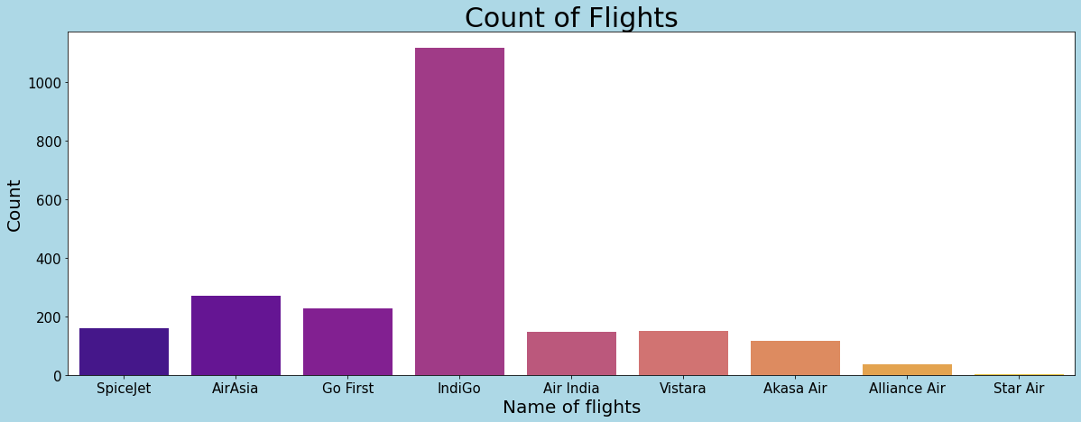
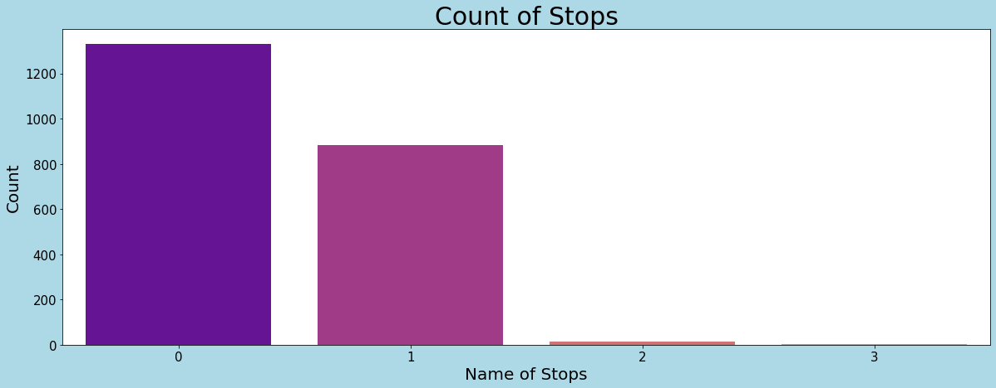
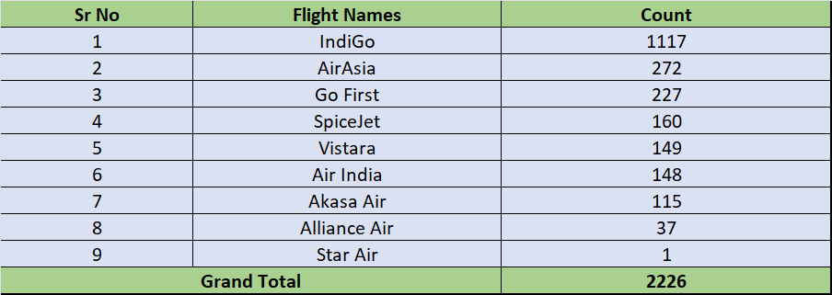
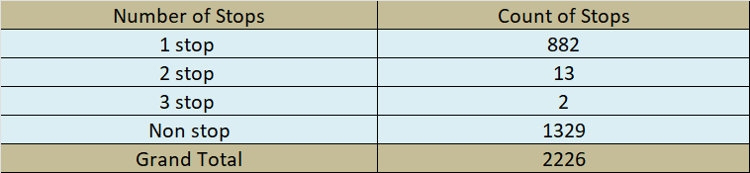
Visualization: Univariate Analysis
In our data, the most numbers of flights are IndiGo with 1117 flights and the least is Star Air with only one flight, AirAsia and Go First flights have a count of 272 and 227 respectively.
1329 flights are nonstop, and 882 flights are with 1 stop. Also the count of flights with 2 or 3 stops is less, they are 13 and 2 respectively for 2 and 3 stops respectively.

Slide 8
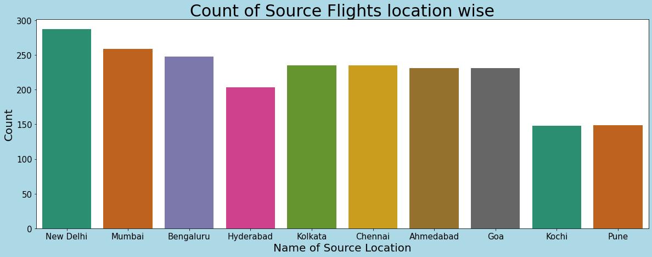
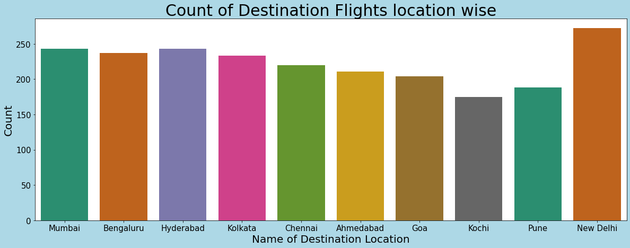
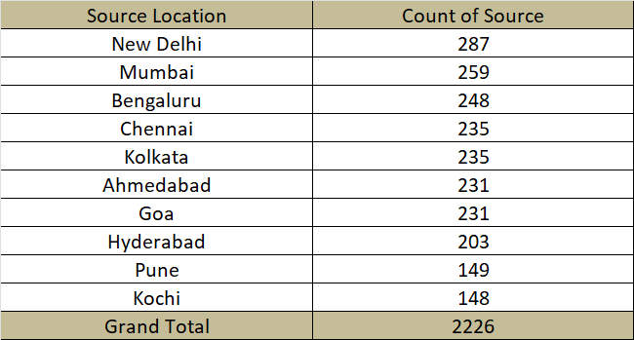
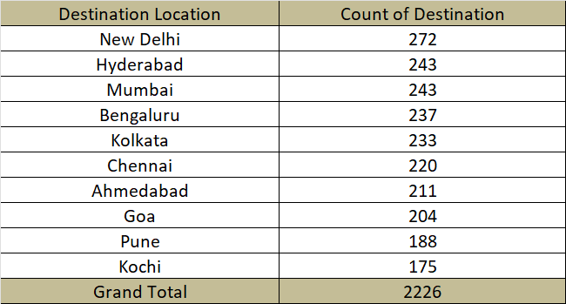
Visualization: Univariate Analysis
Most numbers of flights started from New Delhi in our data followed by Mumbai and Bengaluru, Pune and Kochi have the least number of flights at the source location in our dataset.
New Delhi has the highest count of Destination points followed by Mumbai and Hyderabad with the same count, Pune and Kochi have the least count with 188 and 175 Destination counts respectively.

Slide 9
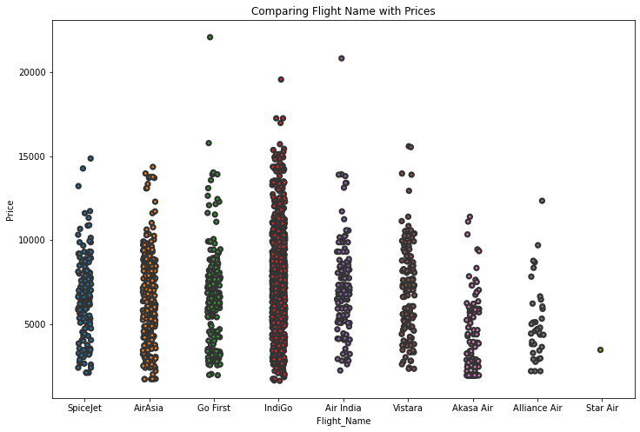
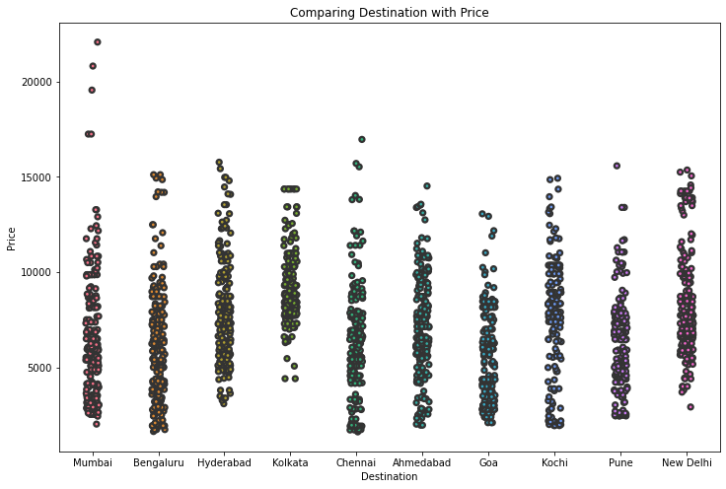
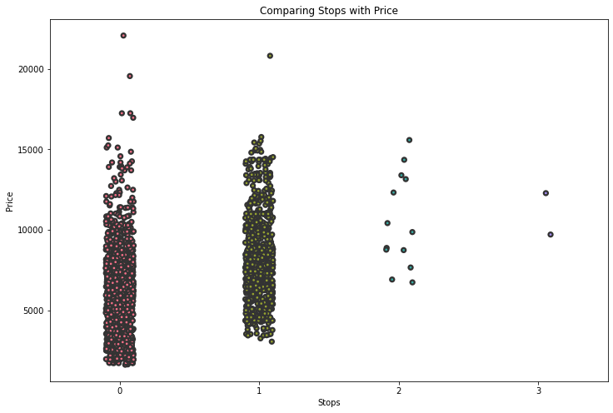
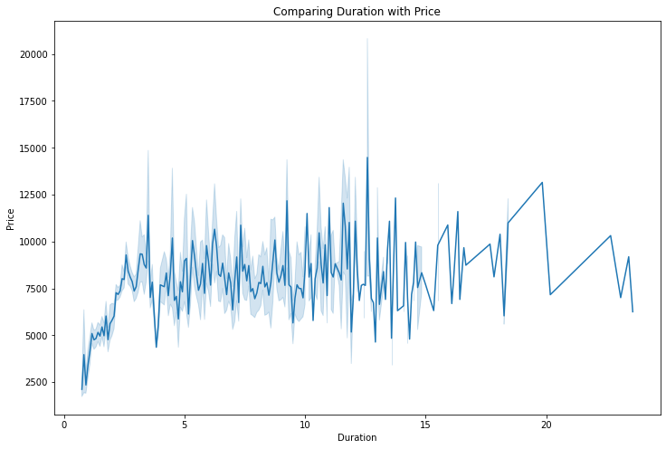
Visualization: Bivariate Analysis
Kolkata's basic price starts from above 5000 which is more than compared with other flights. Also where Kolkata is the destination basic price is showing above 5000. The price of Flights keeps increasing with every stop, the price with no stops has a less basic price as compared to flights with 1, 2, and 3 stops. With the above graph, we can see that as the duration of a flight increases price range also gets increasing.

Slide 10
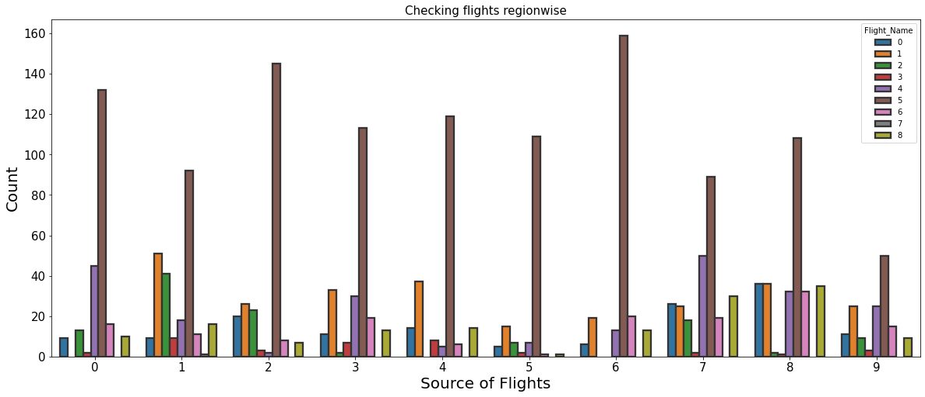
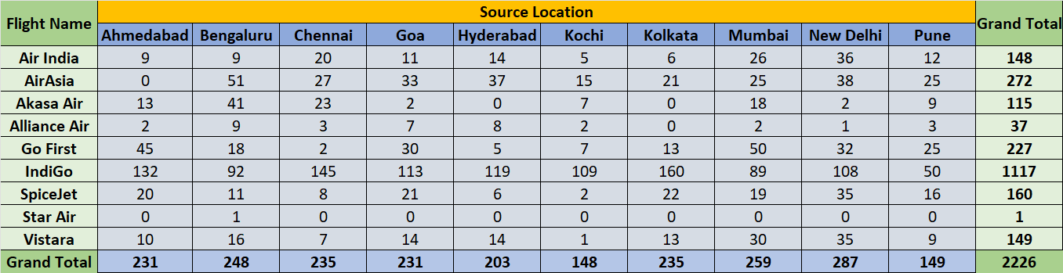
Visualization: Multivariate Analysis
Observation
IndiGo flight is the most with 1117 flights in each Source Location, it actually has the most number of running flights in these locations.
AirAsia is at second number with 272 flights from the source location.
Start Air has the least number of flights in our data with only 1 flight.

Slide 11
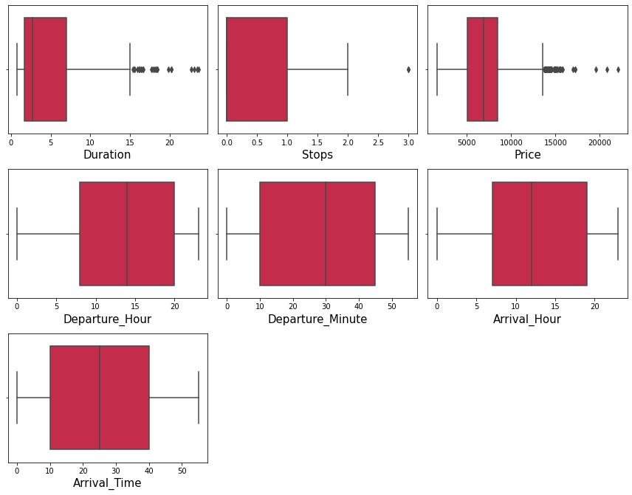
Outliers
Outliers are present in the Duration, Stop and Price columns, we will remove outliers from the Duration column and price is our target column we won’t remove outliers from this column stop has only one outlier which is not required to be removed.
Let’s remove the outlier of the Duration column using the z score method.

Slide 12
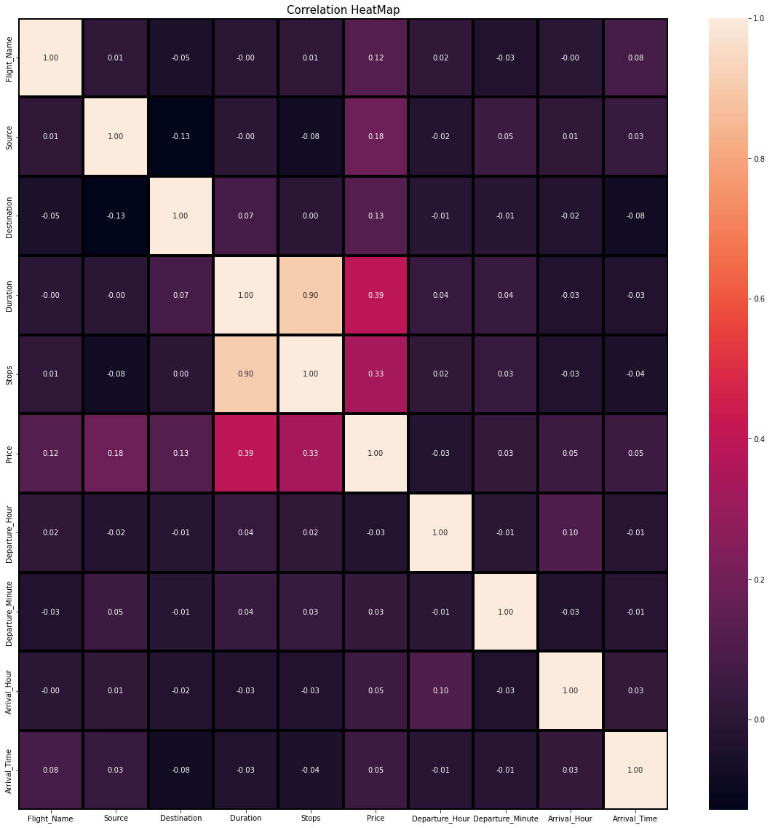
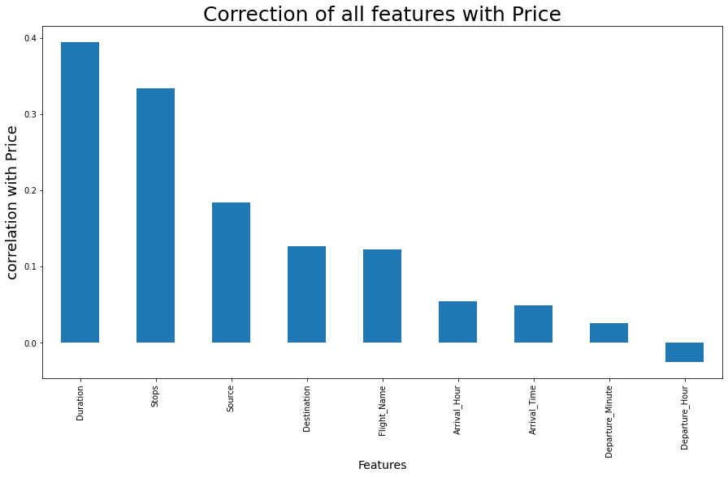
Correlation using heatmap Correlation with the target variable
All features have a positive correlation with the target column (price), except Departure hour which has a bit negative correlation with the target column.

Slide 13
Model Building
This is a regression model, we will use below regression algorithms to build our model.
1. DecisionTreeRegressor
2. RandomForestRegressor
3. Gradient Boosting Regressor
4. Bagging Regressor
5. ExtraTreesRegressor

Slide 14
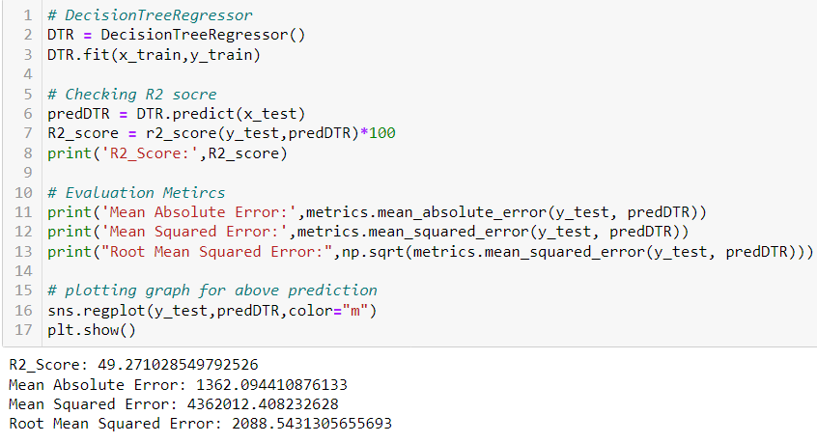
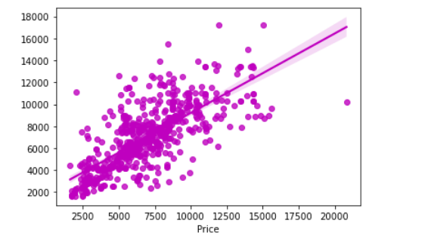
DecisionTreeRegressor
Created the Decision Tree Regression model and verified the metrics used for evaluation.
The R2 score provided by the model is 49.27.

Slide 15
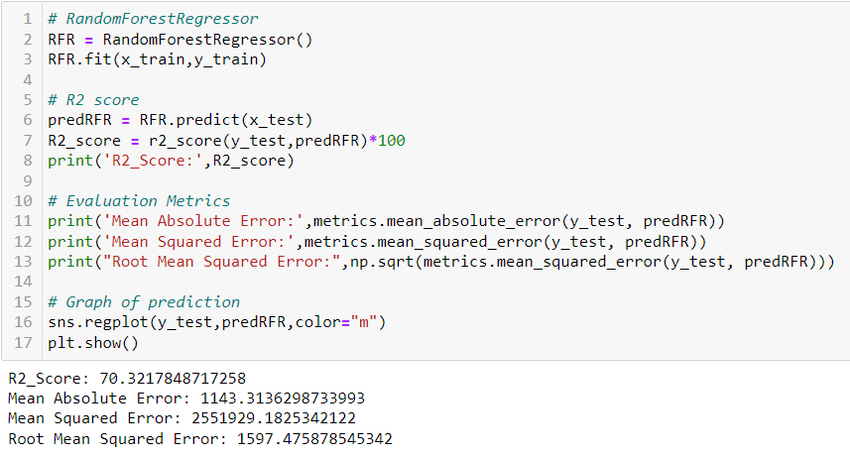
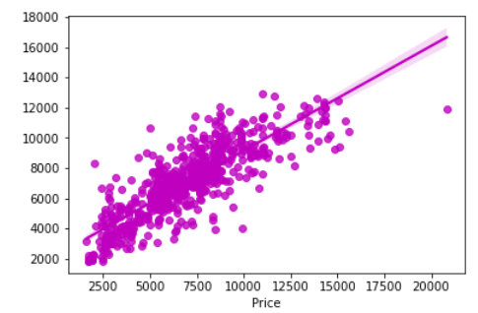
RandomForestRegressor
Created the RandomForestRegressor model and verified the metrics used for evaluation.
The R2 score provided by the model is 70.32.

Slide 16
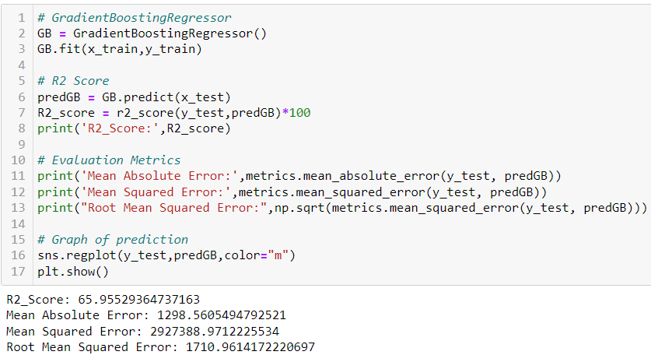
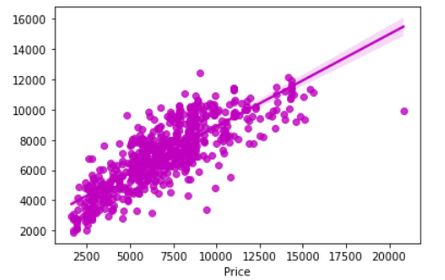
GradientBoostingRegressor
Created the GradientBoostingRegressor model and verified the metrics used for evaluation.
The R2 score provided by the model is 65.95.

Slide 17
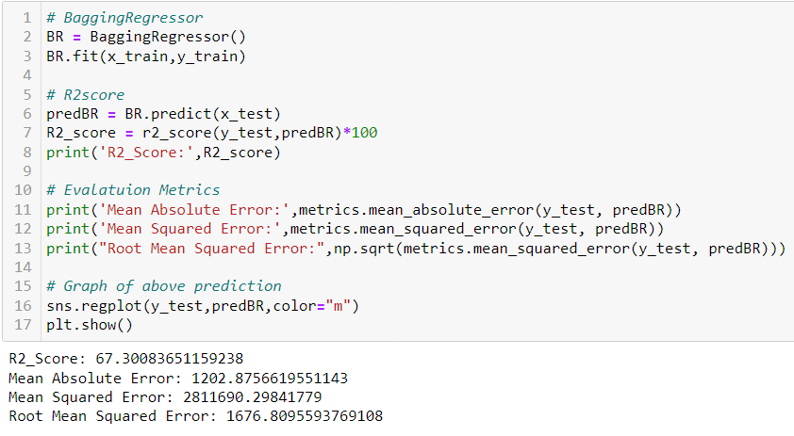
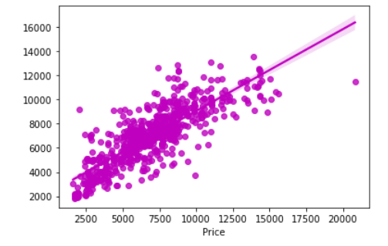
Bagging Regressor
Created the Bagging Regressor model and verified the metrics used for evaluation.
The R2 score provided by the model is 67.30.

Slide 18
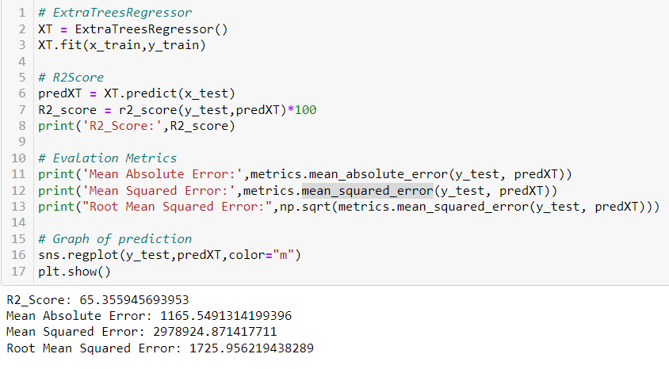
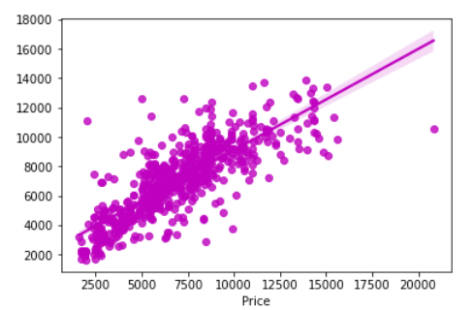
ExtraTreesRegressor
Created the ExtraTreesRegressor model and verified the metrics used for evaluation.
The R2 score provided by the model is 65.35.

Slide 19
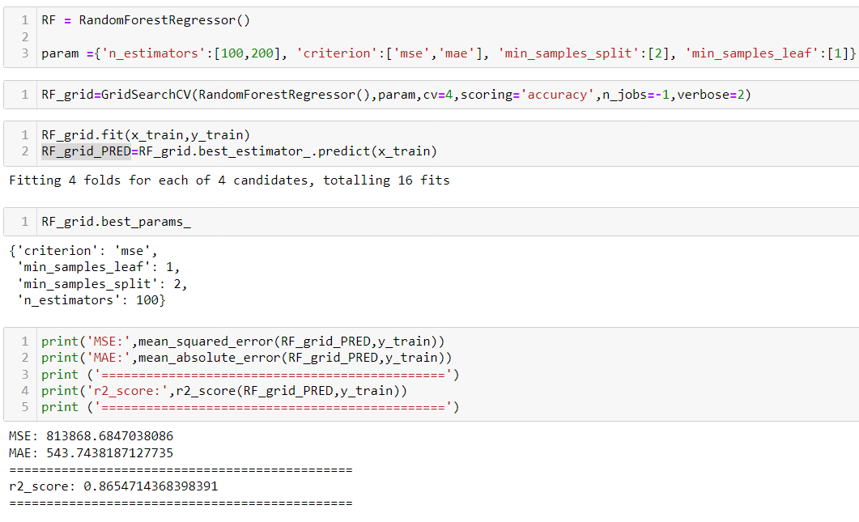
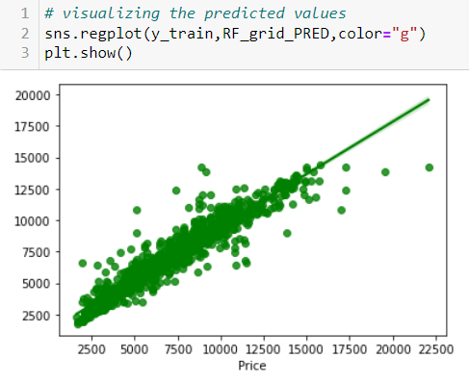
Model Selection using Hyper Parameter Tuning
After successfully incorporating hyperparameters tweaking using the optimal RandomForestRegressor values, the model's R2 score grew and now stands at 86.54% percent, which is a highly respectable result. We can see how our final model is translated from the graph. The best-fit line, which represents our real datasets, can be seen in the graph, and the dots represent the predictions that our best final model made.

Slide 20
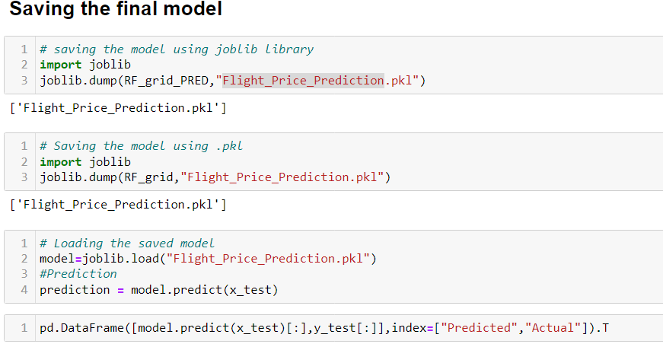
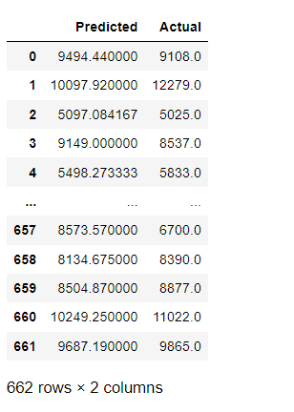
Saving Model
We were able to anticipate the cost of the airline tickets using a regression model. We can see from the output above that the projected values are quite close to the real numbers.

Slide 21
Conclusion
The case study attempts to provide an example of how machine learning algorithms may be used to forecast the cost of airline tickets. when this project is finished. We gained an understanding of the data collection, pre-processing, analysis, cleaning, and model-building processes.
First, we used web scraping to gather flight information from the www.makemytrip.com website. Selenium was the technology utilized for web scraping, which offers the benefit of automating our data collection process. We gathered roughly 2333 pieces of information, including the cost of airline tickets and other relevant details. The scraped data was then stored in an excel file so we could utilize it later and analyze it.
After loading the dataset, we cleaned the data. Data visualization was improved by the use of the EDA process and pre-processing techniques such as skewness, correlation, scaling, and outlier detection.
As this is a regression problem, we finally began developing our models. To predict our models, we used 5 different regression methods. The Random Forest Regressor was the most accurate of the group, and after being hyper-tuned, it became even more accurate.

